Slide 1
AC6761 Artificial Intelligence Accounting
Chapter 3 Annual report analyses

Slide 2
Components of Annual Report
Corporate Profile
Directors and Senior Management Profile
Directors’ Report
Chairman’s Statement
Management’s Discussion and Analysis (MD&A)
Corporate Governance Report / ESG Report
Auditor’s Report
Consolidated Statement of Profit or Loss
Consolidated Statement of Financial Position
Consolidated Cash Flow Statement
Statement of Changes in Equity
Notes to the Accounts
Financial Highlights and Supplementary Information

Slide 3
Balance Sheet
(Statement of financial position)

Slide 4
Balance Sheet
Snapshot of financial position on a given day
Assets: resources that provide probable future economic benefits
  To be reported on a balance sheet, an asset must:
    Be owned or controlled by the company
    Possess expected future benefits
Liabilities: the claims on assets by creditors
  Fixed return with lower risk - creditors
Equity: the claims on assets by shareholders
  Residual claim after creditors
  Higher risk - shareholders

Slide 5
Balance Sheet
Current Assets:
  can be converted to cash within one year or one operating cycle, whichever is longer
  operating cycle is the time for a firm to convert cash back into cash (i.e., purchase material, manufacture product, sell product, and collect cash)
  e.g., inventories, accounts receivables, cash and cash equivalents
Non-Current Assets:
  cannot be easily converted to cash
  plant property & equipment (PP&E)
  investments
  intangibles

Slide 6
Non-Current Assets
Plant, Property & Equipment (PP&E)
  Tangible, fixed asset (usually illiquid); Percentage of PP&E to total assets varies by industry
  If at historical cost, subject to depreciation policy
  Most at historical cost and different from market value
Investments
  Expected to hold more than one year or operating cycle
  Long-term equity investments in subsidiaries or others
  Long-term debt investments with long maturity
  Investment property for price increase
  Could bear risk of market fluctuation in value

Slide 7
Non-Current Assets
Intangibles
  Patents, trademarks, copyrights, etc.
  Purchased goodwill in M&A transactions
    purchase price – fair value of target’s net asset
  Internally generated goodwill is generally not shown as an asset
    e.g., customer relationship, trained employee skills, reputation built in the market
    hard to identify and value in a reliable way

Slide 8
Current Assets
Inventories
  Sizable item for manufacturing / retailing corporations
  Essential for business, but tie up capital: putting in warehouses before being sold
  Conservatively reported at the lower of historical cost or net realizable value.
  Could be an easy item for earnings management or even fraud (e.g., delay impairment, fake inventories)

Slide 9
Current Assets
Accounts Receivables
  Normally readily available within a short period without significantly affecting the presented value
Cash and Cash Equivalents
  The prime item to verify liquidity

Slide 10
Balance Sheet
Current Liabilities
  settled within one year or operating cycle, whichever is longer
  accounts payable
  short-term debt; long-term debt comes to due
  accrued expenses
  deferred revenue
Non-Current Liabilities
  long-term debt
  bonds payable

Slide 11
Balance Sheet
Equity
Common or Preferred Stock (share capital)
Additional Paid-in Capital (share premium)
Treasury Stock
Retained Earnings
Accumulated other comprehensive income/loss
  unrealized and usually related to the market price change of long-term holdings
  e.g., unrealized gains or losses on available-for-sale securities: buy at $100 and the price increases to $150 at year-end. the $50 is not realized as the security has not been sold. but needs to reflect such value change in the long-term held security.

Slide 12
Balance Sheet
Equity
Non-controlling interests
  parent firm A owns 80% of subsidiary firm B
  net assets of subsidiary firm B is $100
  equity by parent firm A is $80
  remaining $20 is owned by others
  consolidated financial statement includes firm B’s assets and liabilities, and lists the $20 equity owned by other non-controlling holders of firm B
  similarly, if firm B’s net profit is $10, then list $2 for non-controlling interests on income statement

Slide 13
Balance Sheet
Key information:
  Major assets owned
  Size of the company (total assets or net assets after liabilities)
  How assets are financed (debt, equity and internal financing)
  How much debt the firm must repay next year
  How much cash or quick assets the firm has on hand to repay the debt due next year
  Trends or abrupt changes in major assets, liabilities and equity during a period of time
Weaknesses:
  Book value based on historical cost and depreciation is reliable but not representative of the current fair value at the market
  Some assets and liabilities are not recognized on the balance sheet.
    e.g., research and development ability, intangible assets developed within the firm, contingent lawsuits with uncertainty

Slide 14
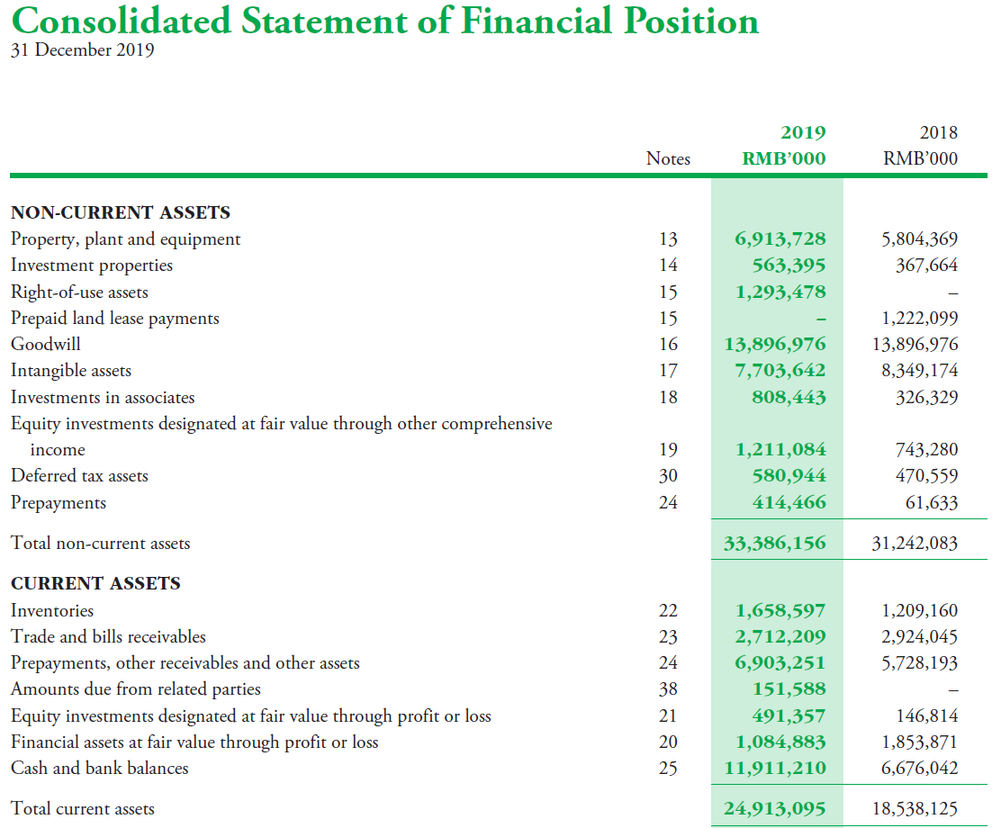

Slide 15
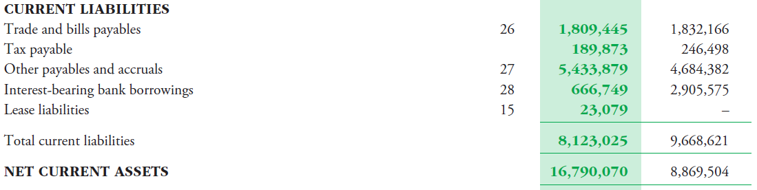
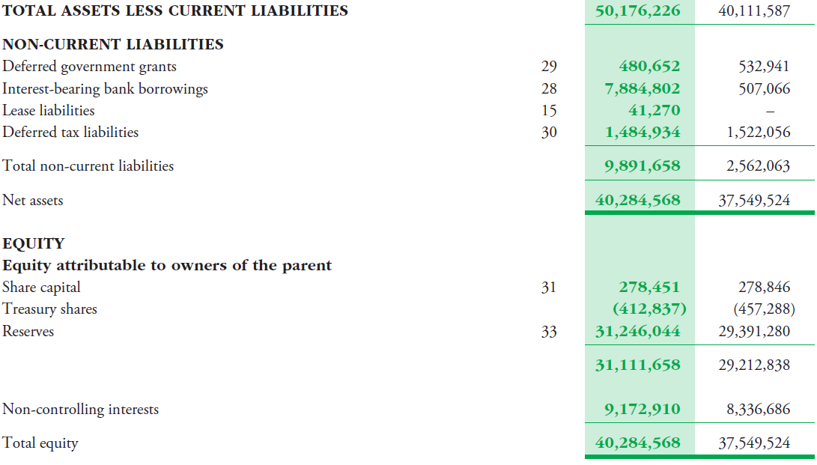

Slide 16
Common-Size Financial Statements
Common-size analysis converts financial statement line items into percentages of either total sales (for income statement) or total assets (for balance sheet).
  Allows comparing financial statements across firms and across time for the same size.
  Help evaluating financial statements reported with different currencies, or financial statements of firms of different size

Slide 17
Common-Size Balance Sheet
 | Company A | Company B
Current Assets | $2,000,000 | $25,000,000
Non-current Assets | $1,000,000 | $10,000,000
Current Liabilities | $500,000 | $3,000,000
Non-current Liabilities | $1,500,000 | $12,000,000
Shareholders’ Equity | $1,000,000 | $20,000,000

Slide 18
Common-Size Balance Sheet
 | Company A | Company B
Current Assets | 66.7% | 71.4%
Non-current Assets | 33.3% | 28.6%
Current Liabilities | 16.7% | 8.6%
Non-current Liabilities | 50% | 34.3%
Shareholders’ Equity | 33.3% | 57.1%

Slide 19
Case : Nike
Analyzing Balance Sheet

Slide 20
Nike: Strategy
Nike, Inc.’s principal business activity involves the design, development, and worldwide marketing of athletic footwear, apparel, equipment, accessories, and services for serious and recreational athletes. Nike boasts that it is the largest seller of athletic footwear and apparel in the world. Nike sells products to retail accounts, through Nike-owned retail stores and Internet websites, and through a mix of independent distributors and licensees throughout the world. Nike outsources its production: Nearly all of Nike’s footwear and apparel products are produced in Asia (Vietnam, China, and Indonesia) and elsewhere outside of the United States by independent manufacturers, while equipment products are produced both in the United States and abroad.
https://investors.nike.com/Home/default.aspx.

Slide 21
Nike: Strategy
Nike targets the serious athlete as well as the recreational athlete with performance-driven footwear, apparel, and equipment. The firm has steadily expanded the scope of its product portfolio from its primary products of high-quality athletic footwear for running, training, basketball, soccer, and casual wear to encompass related product lines such as sports apparel, bags, equipment, balls, eyewear, timepieces, and other athletic accessories. In addition, Nike has expanded its scope of sports, now offering products for swimming, baseball, cheerleading, football, golf, lacrosse, tennis, volleyball, skateboarding, and other leisure activities. In recent years, the firm has emphasized growth outside the United States. Nike also has grown by acquiring other apparel companies, including Cole Haan, Converse, Hurley, and Umbro.
To maintain its technological edge, Nike engages in extensive research at its research facilities in Beaverton, Oregon. It continually alters its product line to introduce new footwear, apparel, equipment, and evolutionary improvements in existing products.
https://investors.nike.com/Home/default.aspx.

Slide 22
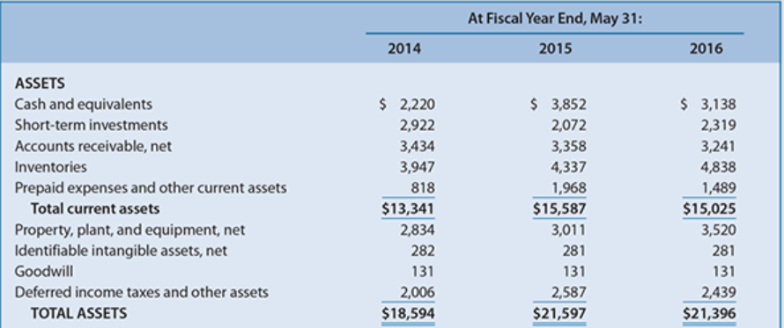
Nike: Balance Sheet (Assets)

Slide 23
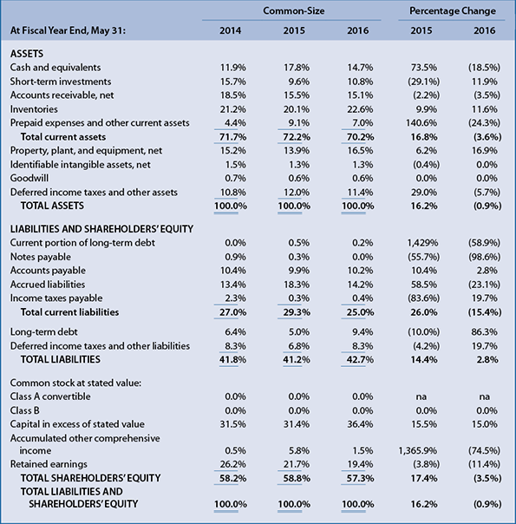
Nike: Common-Size Balance Sheet (Assets)

Slide 24
Nike: Common-Size Balance Sheet (Liabilities and Shareholders’ Equity)

Slide 25
Nike: Excerpts from Notes
Property, Plant and Equipment and Depreciation: Property, plant and equipment are recorded at cost. Depreciation is determined on a straight-line basis for buildings and leasehold improvements over 2 to 40 years and for machinery and equipment over 2 to 15 years.
Identifiable Intangible Assets and Goodwill: This account represents the excess of the purchase price of acquired businesses over the market values of identifiable net assets

Slide 26
Nike: Analyzing Balance Sheet
Refer to the common-size and percentage change balance sheets for Nike at the end of 2014, 2015, and 2016. What is the likely explanation for the relatively small percentages for property, plant, and equipment?

Slide 27
Nike: Analyzing Balance Sheet
What is the likely explanation for the relatively small percentages for notes payable and long-term debt?

Slide 28
Income Statement
(Statement of profit or loss)

Slide 29
Income Statement
Shows financial performance over a given period
Net Income = Revenues – Expenses + Gains – Losses
  Revenues (Expenses) represent the resources Generated (Consumed) by a firm
  Gains and losses typically result from non-operating or incidental activities that are outside of the core business
When using the income statement to assess a firm’s profitability, it is important to focus not only its current and past profitability, but also the likeliness of sustainable earnings in the future.

Slide 30
Income Statement
Revenue (Sales, Turnover)
– Cost of revenue (Cost of sales, Cost of goods sold)
Gross profit
+ Other income and gains
– Distribution / administration / other expenses
Profit from operations
– Finance costs
Profit before tax
– Tax expense
Profit after tax, attributable to
Shareholders of the company => Earnings per share
Non-controlling interests

Slide 31
Revenues
Revenue
  Magnitude of mainstream source of income
  Sometime called net revenue, turnover, or sales
Gross profits
  GP = Revenue – Cost of Revenue
  Ability to generate profits from revenue
Other revenues
  Income from other sources

Slide 32
Expenses
Distribution – costs incurred while delivering products for sales
Administration – costs to maintain daily operations, such as salary expense
Others – other operational expenses not classified as distribution or administration
Finance – costs incurred in maintaining debt finances (bank loans, etc.)

Slide 33
Income Statement
Key information:
  Magnitudes and trends:
    Profitability (net income or loss) for the period
    Sales revenue for the period
    Major expenses
    Income from operations
    Earnings per share (EPS)
  How is the firm generating most of its income?
    Through main business or other activities? Through recurring or nonrecurring items?
Weaknesses:
  Figures (revenues, expenses, gains and losses) could be manipulated: the quality of earnings may be low.

Slide 34
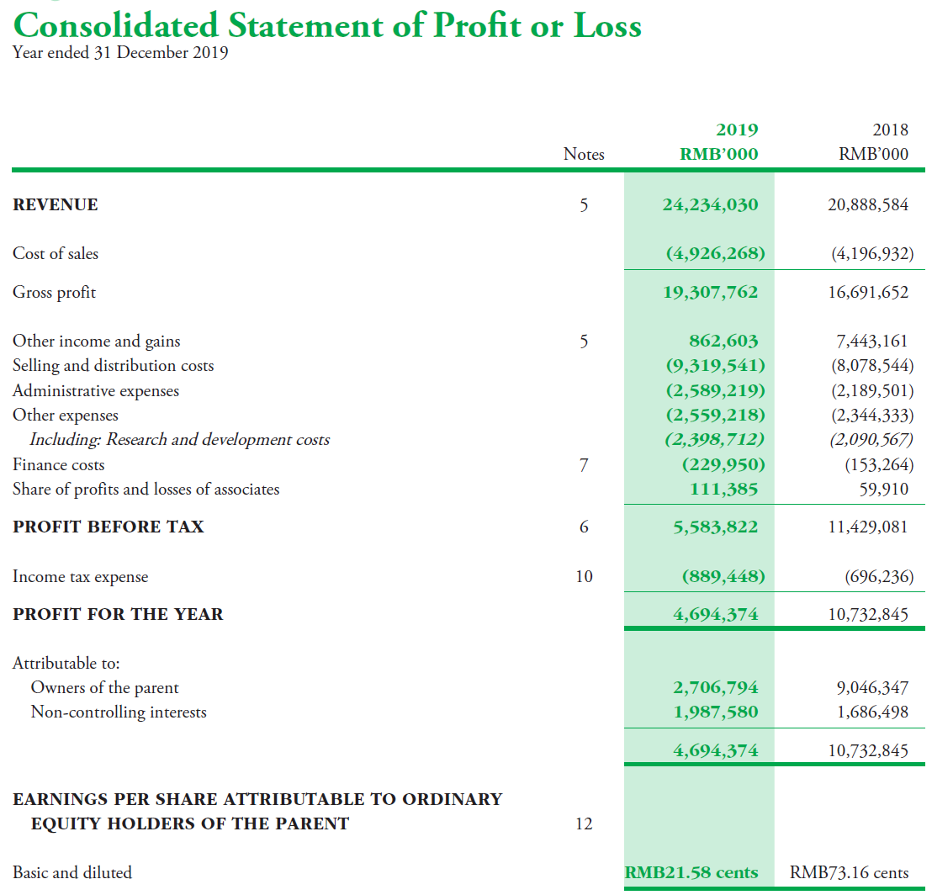

Slide 35
Case: Nike
Analyzing Income Statement

Slide 36
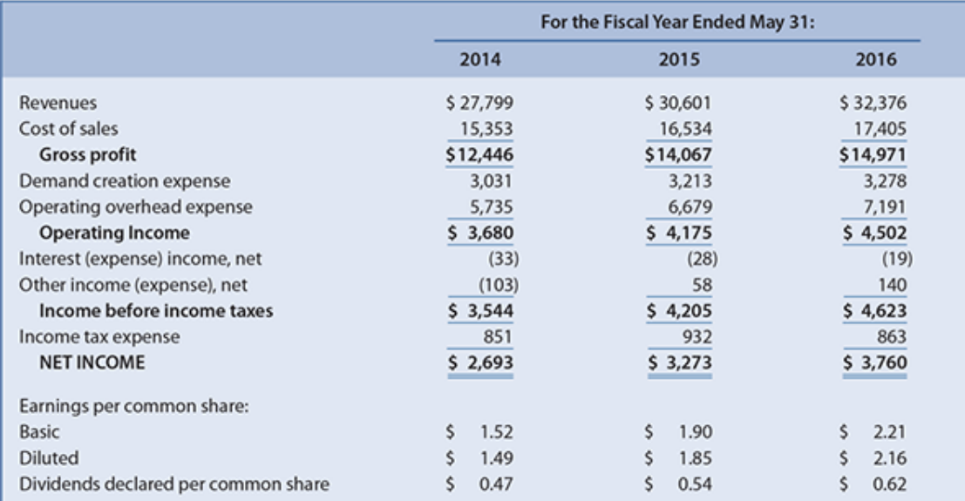
Nike: Income Statement

Slide 37
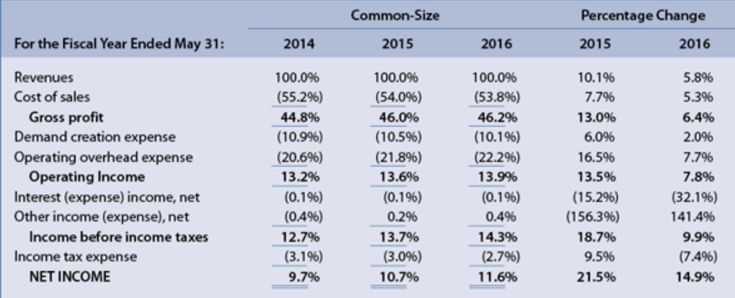
Nike: Common-Size Income Statement

Slide 38
Nike: Excerpts from Notes
Revenue Recognition: Nike recognizes wholesale revenues after the ownership of the products, along with the related risks and benefits, have been passed to the customer, based on the terms of sale. This occurs upon shipment or upon receipt by the customer depending on the country of the sale and the agreement with the customer. Retail store revenues are recorded at the time of sale and online store revenues are recorded upon delivery to the customer. Provisions for post-invoice sales discounts, returns and miscellaneous claims from customers are estimated and recorded as a reduction to revenue at the time of sale.
Demand Creation Expense: Demand creation expense consists of advertising and promotion costs, including costs of endorsement contracts, television, digital and print advertising, brand events and retail brand presentation. Advertising production costs are expensed the first time an advertisement is run.

Slide 39
Cash Flow Statement
(Statement of Cash Flow)

Slide 40
Statement of Cash Flow
Shows cash inflows and outflows over a given period.
  Direct vs. Indirect method
    Direct method partitions cash receipts and cash payments into logical categories, such as cash collected from customers, paid to suppliers, and paid to employees.
    Indirect method reconciles reported net income to cash flows from operations by “unraveling” noncash (i.e., accrual) components of earnings.
    Almost all firms use the indirect method
  Link net income to the change in cash on the balance sheet

Slide 41
Statement of Cash Flow
  Classifies cash flows by main activities:
      Operating Activities (CFO)
        Regular business activities involving the production and delivery of goods or services
        Include net income from the income statement and adjust non-cash items
      Investing Activities (CFI)
        Relate to the acquisition and disposal of assets, such as plant and equipment, and investments in securities.
        Negative value reflects spending cash on investment
      Financing Activities (CFF)
        Relate to cash received from and paid to capital providers such as banks, other lending institutions, and shareholders.
        Reflect capital structure management

Slide 42
Statement of Cash Flow
Potential use of the Statement of Cash Flows:
  Assess extent to which earnings represent economic reality.
  Identify discrepancies between net income and cash flow from operations.
    Ratio of net income to CFO
    Directions and rates of change of net income and CFO
    Increased discrepancy represents a red flag for further investigation
  Assess health and maturity of firms:
    Healthy, mature firms are likely to have positive CFO, negative or positive CFI, and negative CFF.
    Start-up firms are likely to have negative CFO, negative CFI and positive CFF.

Slide 43
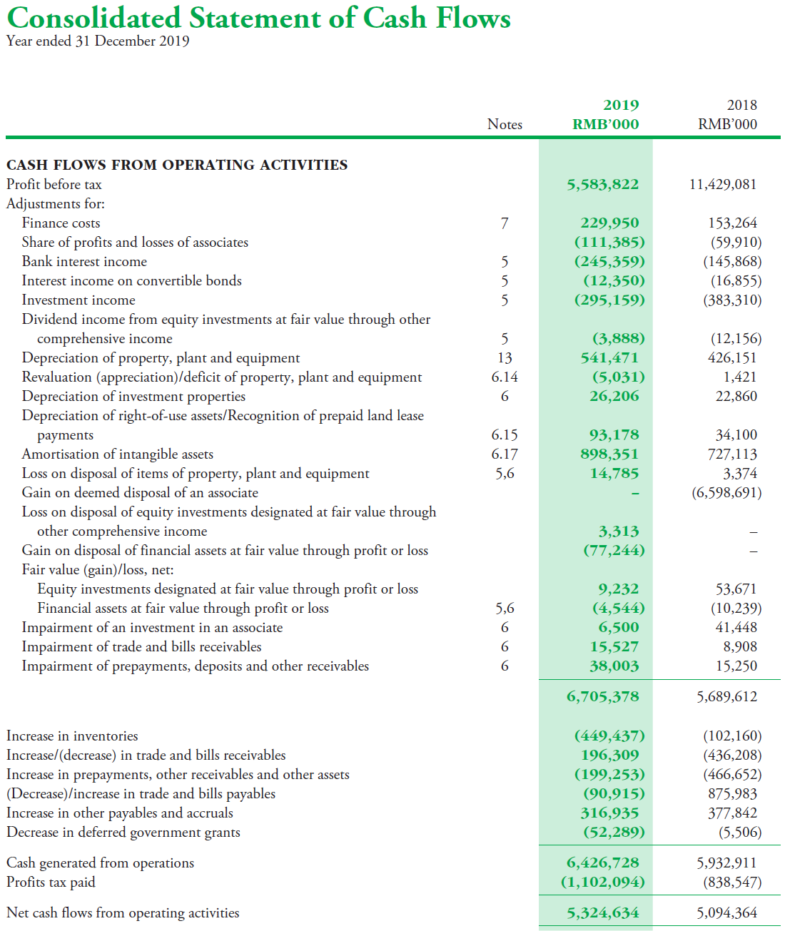

Slide 44
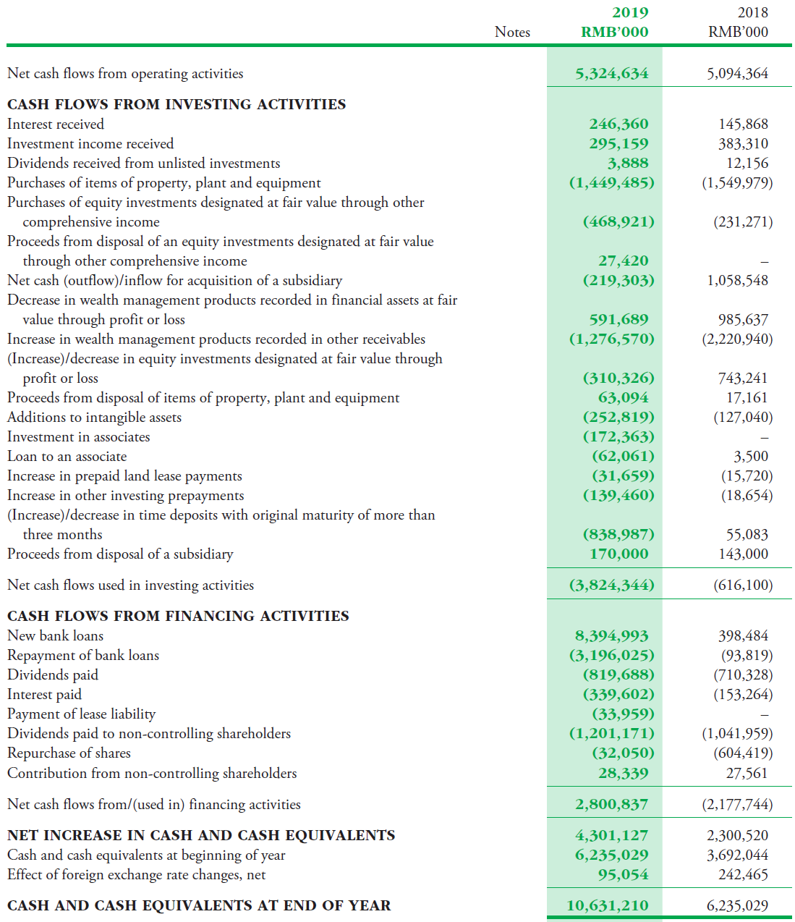

Slide 45
Statement of Changes in Equity
Shows major changes in the interests of company’s shareholders over time.
  Major changes in contributed capital and earned capital:
    Contributed capital consists of common stock, preferred stock, additional paid in capital, and treasury stock.
    Earned capital consists of retained earnings and accumulated other comprehensive income (AOCI).
Additional key information:
  Amount of dividends declared during period
  Number of shares and cost of shares repurchased during period
  Number of shares and price of shares issued during period

Slide 46
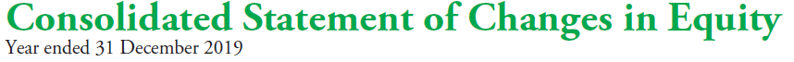
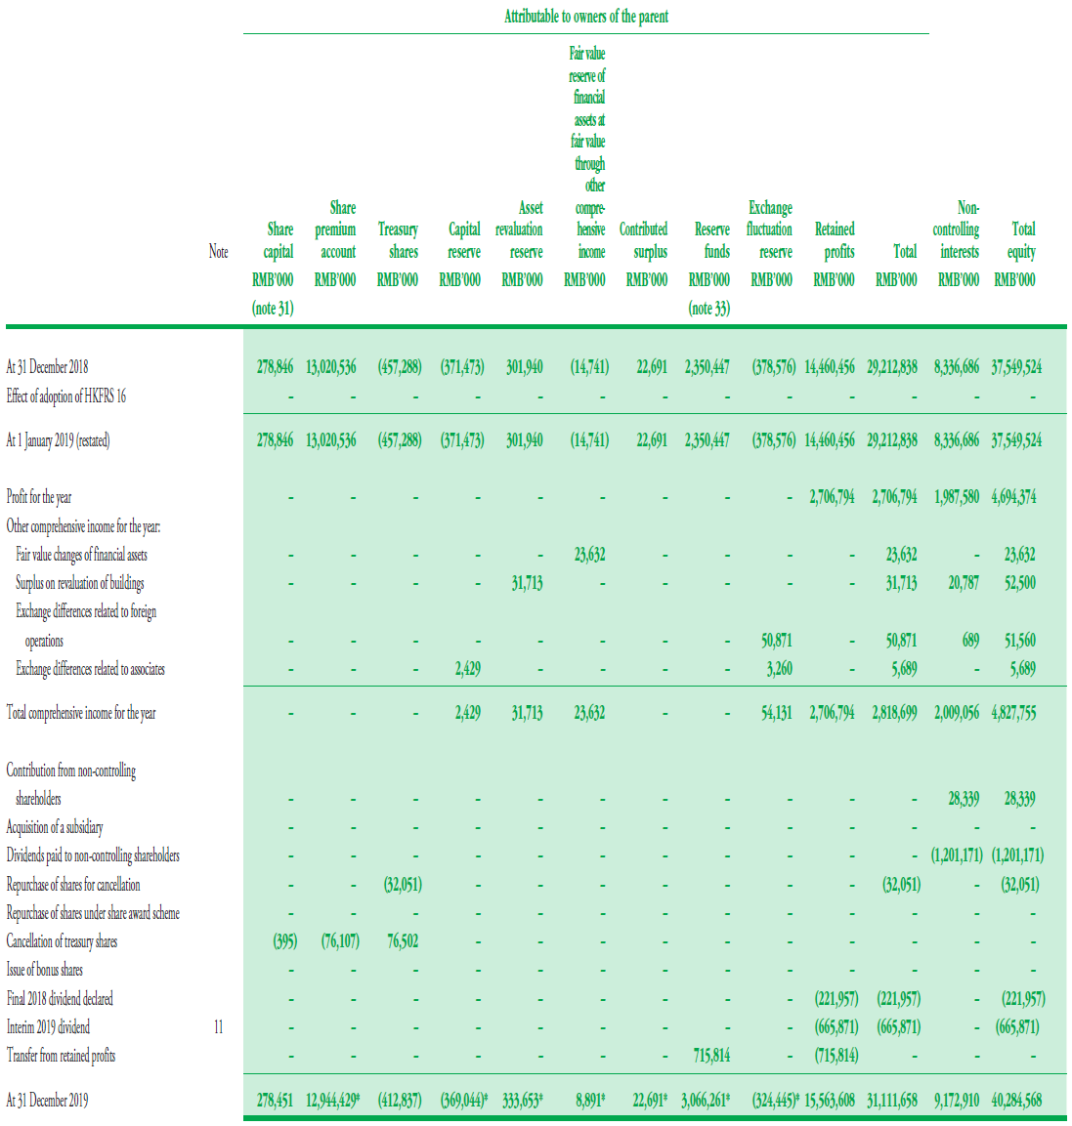

Slide 47
Notes to the Accounts
Provide details about items that appear in the financial statements
Specified by the Companies Ordinance
Note 1 (sometimes Note 2) summarizes the firm’s accounting policies such as valuation method
Breakdown of financial statement items with detailed explanation and elaboration
Whenever you are curious about the aggregated numbers in financial statements, you can always look at their notes for detailed composition, assumption on valuation, etc.

